Slide 1


M.Tech Project Presentation
SAURABH KUMAR PANDEY
17CH30055
DEPARTMENT OF CHEMICAL ENGINEERING
Supervisor: Prof. Somenath Ganguly
Mentor: Dr. Smruti Ranjan Sethi

Slide 2

DEEP LEARNING TECHNIQUES
TO PREDICT
EFFECTIVE DIFFUSIVITY OF POROUS MEDIA FROM IMAGES
CONTENTS
Objective
Dataset
Model Development
Hyperparameter Optimization
Training Plots
Results
Future Work

Slide 3
OBJECTIVE
OBJECTIVE
DATASET
MODEL DEVELOPMENT
HYPERPARAMETER OPTIMIZATION
TRAINING PLOTS
RESULTS
FUTURE WORK
Study of deep learning based approach to study different properties of porous media (currently effective diffusivity)
Optimization of hyperparameters of a convolutional neural network to predict effective diffusivity of porous media
Improving the performance of neural networks through pre-processing pore structures or inducing physical properties like Porosity in the network
1

Slide 4
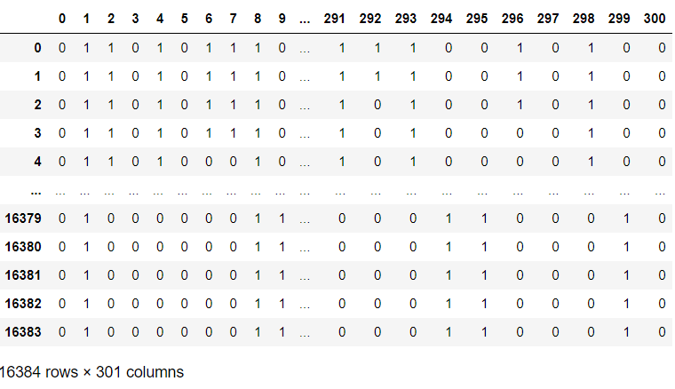
DATASET
OBJECTIVE
DATASET
MODEL DEVELOPMENT
HYPERPARAMETER OPTIMIZATION
TRAINING PLOTS
RESULTS
FUTURE WORK
Dataset is in the form of a csv file and it contains 301 columns and 16384 rows
Each column represents one image and 16384 rows represent a 128x128 binary image
Table - Dataframe with 301 binary images each 128x128 pixels
2

Slide 5
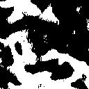
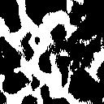
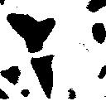
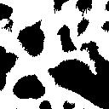
DATASET
OBJECTIVE
DATASET
MODEL DEVELOPMENT
HYPERPARAMETER OPTIMIZATION
TRAINING PLOTS
RESULTS
FUTURE WORK
The images are obtained from the raw csv file using OpenCV library from Python
SEM images of the porous film of a nanostructured electrode used in electrochemical energy storage
Pore space is marked as 0 (black) and solid space is marked as 1 (white)
Figure – Sample SEM images of porous film
The diffusivity values are also provided for corresponding image, these are the target values to be used for model development and training
Mean | 7.607423e-14
Std | 3.261657e-14
Min | 7.837232e-15
Max | 2.948378e-13
Table – Description of diffusivity values for our data
3

Slide 6
MODEL DEVELOPMENT
OBJECTIVE
DATASET
MODEL DEVELOPMENT
HYPERPARAMETER OPTIMIZATION
TRAINING PLOTS
RESULTS
FUTURE WORK
Data Pre-processing
Normalization – Since the diffusivity values are very small, they are normalized by a factor (1.958 x 10^-12) to get all the values in the range 0-1
Train/Val/Test split – The data is split into train (80%), validation (10%) and test (10%). Training data is used to train images, validation data is used to select the model with best set of hyperparameters and test set is used to evaluate the model on test data.
Why Convolution Neural Networks?
CNN are highly popular because of their architecture as there is no need for feature extraction.
CNNs use convolution of image and filters to generate invariant features which are passed on to the next layer. The features in next layer are convoluted with different filters to generate more invariant and abstract features and the process continues till one gets final feature / output which is invariant to occlusions.
Deep convolutional networks are flexible and work well on image data
4

Slide 7
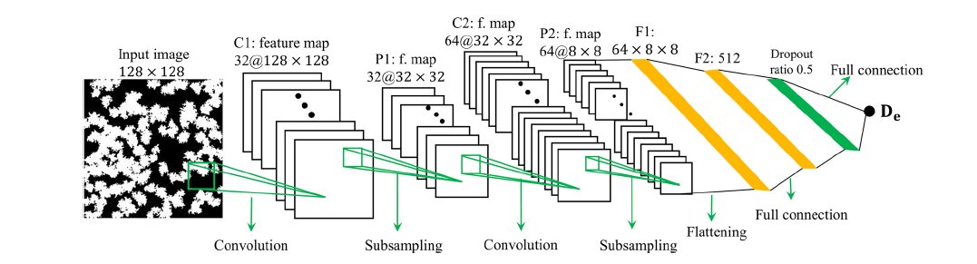
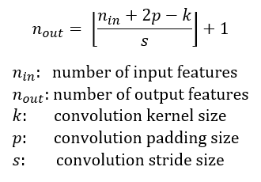
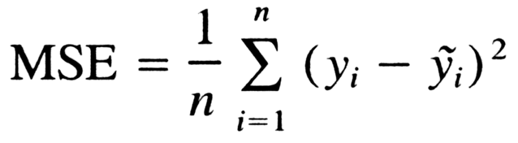
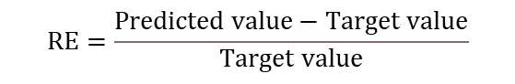
MODEL DEVELOPMENT
OBJECTIVE
DATASET
MODEL DEVELOPMENT
HYPERPARAMETER OPTIMIZATION
TRAINING PLOTS
RESULTS
FUTURE WORK
CNN Model
Figure – 2 layer CNN architecture
Loss Function
Performance Metric
$$RE=\frac{Predicted value−Target value}{Target value}$$
5

Slide 8
HYPERPARAMETER OPTIMIZATION
OBJECTIVE
DATASET
MODEL DEVELOPMENT
HYPERPARAMETER OPTIMIZATION
TRAINING PLOTS
RESULTS
FUTURE WORK
Kernel size | (2,2) | (3,3) | (4,4) | (5,5)
Learning Rate | 1e-2 | 1e-3 | 1e-4
Number of filters | (8,16) | (16,32) | (32,64)
Strides | (2,2) | (3,3) | (4,4)
Pool size | (2,2) | (3,3) | (4,4)
Padding | “same” | “valid”
Activation | ReLU | Linear
Table – Test hyperparameters of the CNN model
900 different valid combinations of the above hyperparameters have been trained and tested
The results for all 900 models have been logged in results_linear.txt and results_ReLU.txt
6

Slide 9
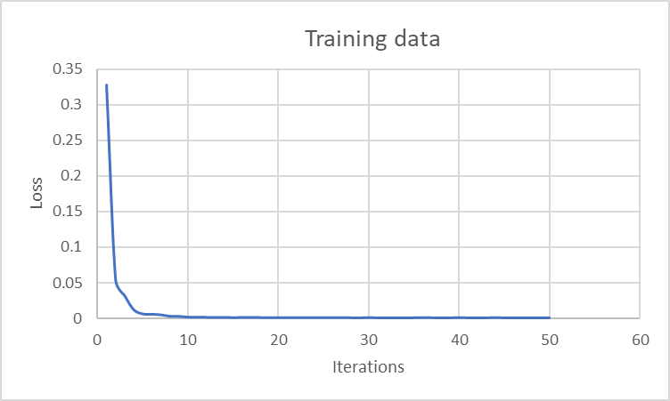
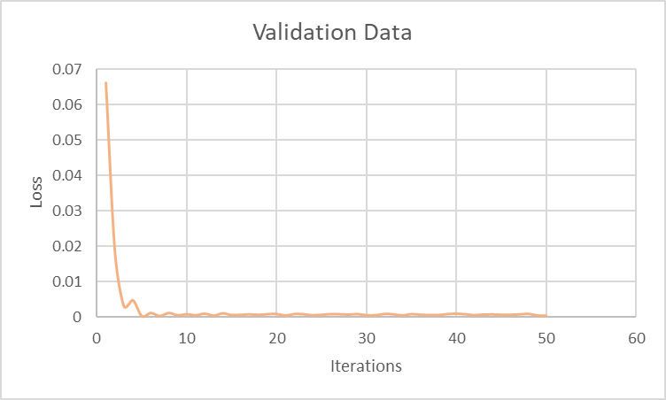
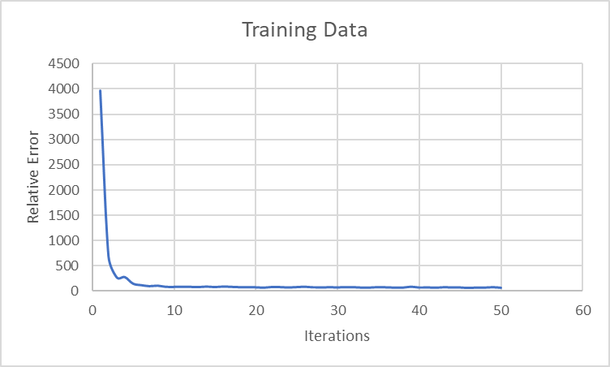
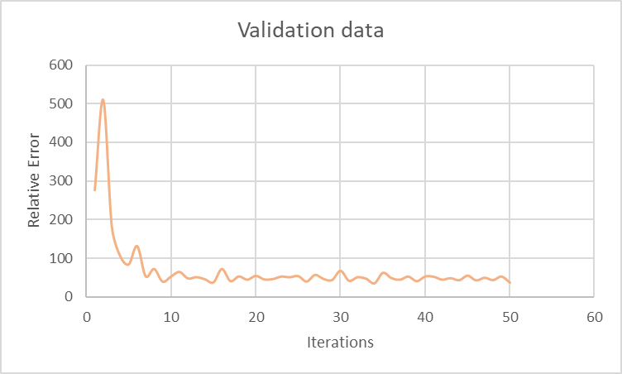
TRAINING PLOTS
OBJECTIVE
DATASET
MODEL DEVELOPMENT
HYPERPARAMETER OPTIMIZATION
TRAINING PLOTS
RESULTS
FUTURE WORK
Figures – Training Plots on Loss & Relative Error on training and validation data
7

Slide 10
RESULTS
INTRODUCTION
DATASET
MODEL DEVELOPMENT
HYPERPARAMETER OPTIMIZATION
TRAINING PLOTS
RESULTS
FUTURE WORK
Kernel size | (4,4)
Learning Rate | 1e-2
Number of filters | (8,16)
Strides | (3,3)
Pool size | (3,3)
Padding | “valid”
Activation | Linear
Kernel size | (5,5)
Learning Rate | 1e-2
Number of filters | (32,64)
Strides | (3,3)
Pool size | (2,2)
Padding | “valid”
Activation | ReLU
Table – Hyperparameter configuration for best model with Linear Activation function
Table – Hyperparameter configuration for best model with ReLU Activation function
Train Set | 35.79
Validation Set | 30.73
Test Set | 39.71
Train Set | 39.66
Validation Set | 36.39
Test Set | 45.55
Table – Train, Val and Test Relative Error for CNN with Linear Activation function
Table – Train, Val and Test Relative Error for CNN with ReLU Activation function
8

Slide 11
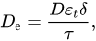
FUTURE WORK
OBJECTIVE
DATASET
MODEL DEVELOPMENT
HYPERPARAMETER OPTIMIZATION
TRAINING PLOTS
RESULTS
FUTURE WORK
Porosity Informed CNN
The key features are extracted through the convolutional layers and these features are mostly connected with the input images locally.
Global features or features spanning large scale may not be effectively extracted using the CNN, which may compromise the predictive power of the CNN.
It may be useful to directly introduce physical parameters describing these features into the CNN model to improve its performance.
Pre-processed pore structures as input
CNNs exhibits relatively large error for porous samples with very small diffusivity because of the more complex transport behaviour in porous media with very small diffusivities.
In these media, the diffusion pathways are tortuous and there exist many trapped pores and dead-end paths
We would like to explore the possibility of improving CNN prediction by processing the images of porous structures to remove dead-end and trapped pore spaces.
9
Notes:
Since CNN models may not effectively extract features of these complicated structure spanning relatively large length scales using filters with small spatial extent, they do not perform well for such porous media.

Slide 12
THANK YOU

